Slide 1
Goal Setting
Session 1
College Prep
Mr. Gordon
jgordon@bisdtx.org

Slide 2
Upcoming Events
hi

Slide 3
Short-Term Goals
There are short-term and long-term goals.
Let’s define short-term as anything within six months.
Examples may include:
Saving $200 for a trip in July
Getting your driver’s permit in December
Or getting an A on a test next week.
hi

Slide 4
Long-Term Goals
Long-term can be six months to five years.
Examples may include:
Getting accepted and attending Texas A&M University
Saving $2000 to buy a car
Or traveling to Japan.
hi

Slide 5
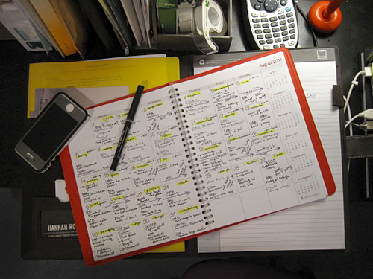
Assignment
Brainstorm and jot down three short-term and two long-term goals.
Your goals must be written down. Take a picture on your phone.
We will use these goals in the
next session.
hi

